Slide 1
COMP 490/L. Senior Design
Project I and Lab (2/1)
Fall 2024
Project Requirements
FitGenius Mobile App
Team #3

Slide 2
Meet The Team!
Isai
Flores
Emanuel
Diaz
Arpa Hakopian
Mirna
Farahat
Sergio
Garcia
Project Lead:
Team Members:

Slide 3
01
Project Overview
What’s the million dollar idea?

Slide 4



Project Overview
Description…
Our big idea…
The aim of our project is to create an AI powered fitness/nutrition app which intakes user data and generates fitness and meal suggestions. Secondarily, the app would allow for personal avatar integration.

Slide 5

Project Overview - AI Feature
Chat Box…
Flexibility for the user
Personalized experience
Caters to injuries and disabilities
Setting boundaries for responses (along with questions) to ensure safe and medically accurate information
Ex:
“I have 30 minutes what’s a quick upper body workout I can do that won't strain my shoulder?”
“What’s a meal I can make that will help me reach my daily protein goals?”

Slide 6

Project Overview - Avatars
Personalized Avatars…
User creates a personalized avatar which displays on their profile
Bridges the gap between technology and biology
Unlock avatar features (outfits and accessories) along with milestones
Allows users to identify with their profile, encouraging consistent tracking
“If you don’t have the cool outfit, does it really count?”
“What’s a workout without FitGenius”

Slide 7
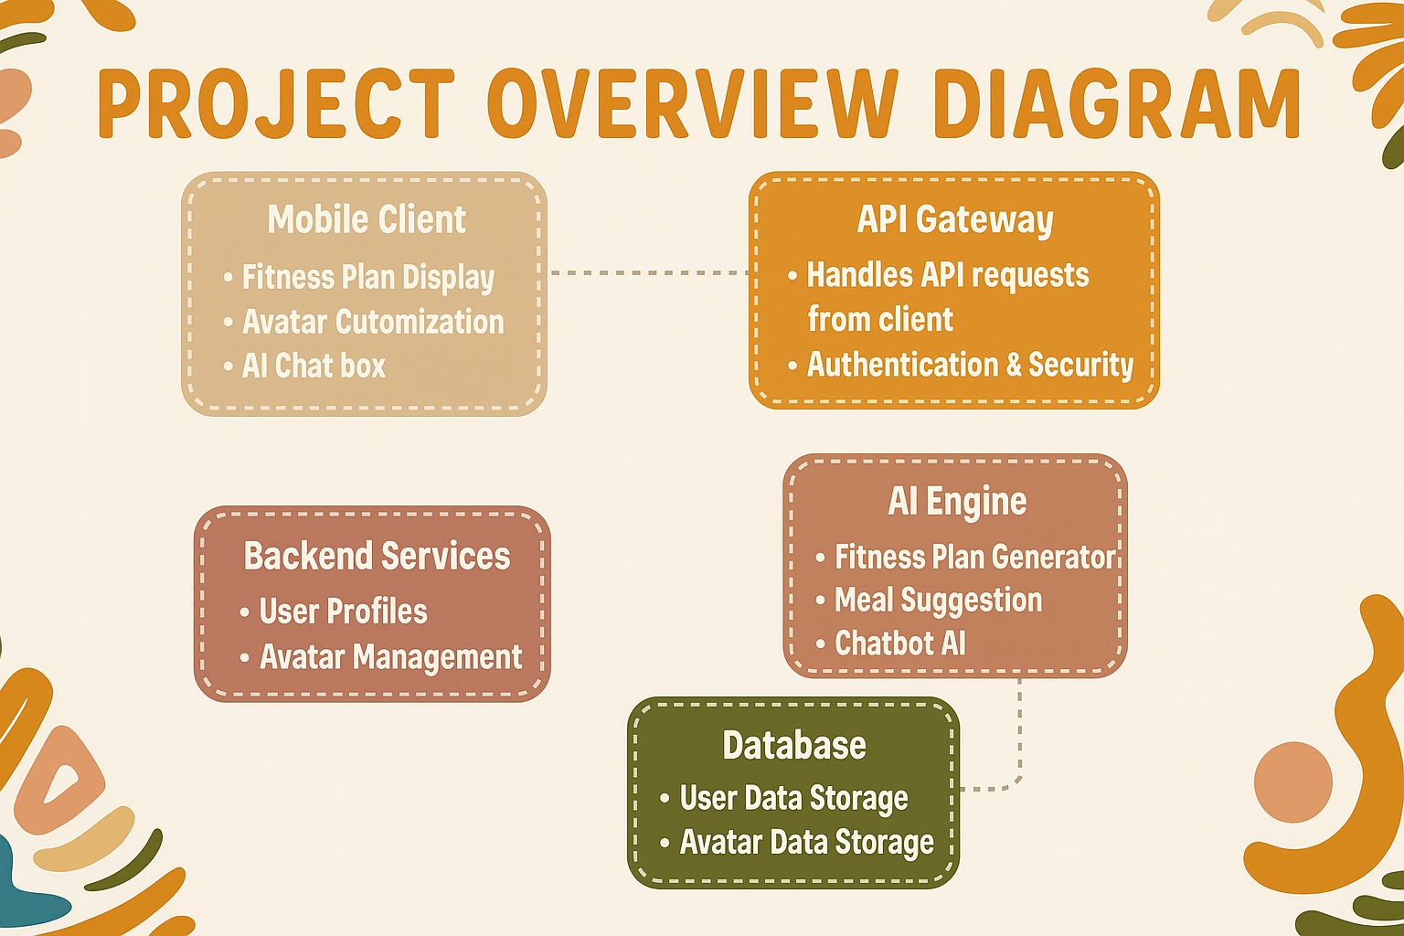
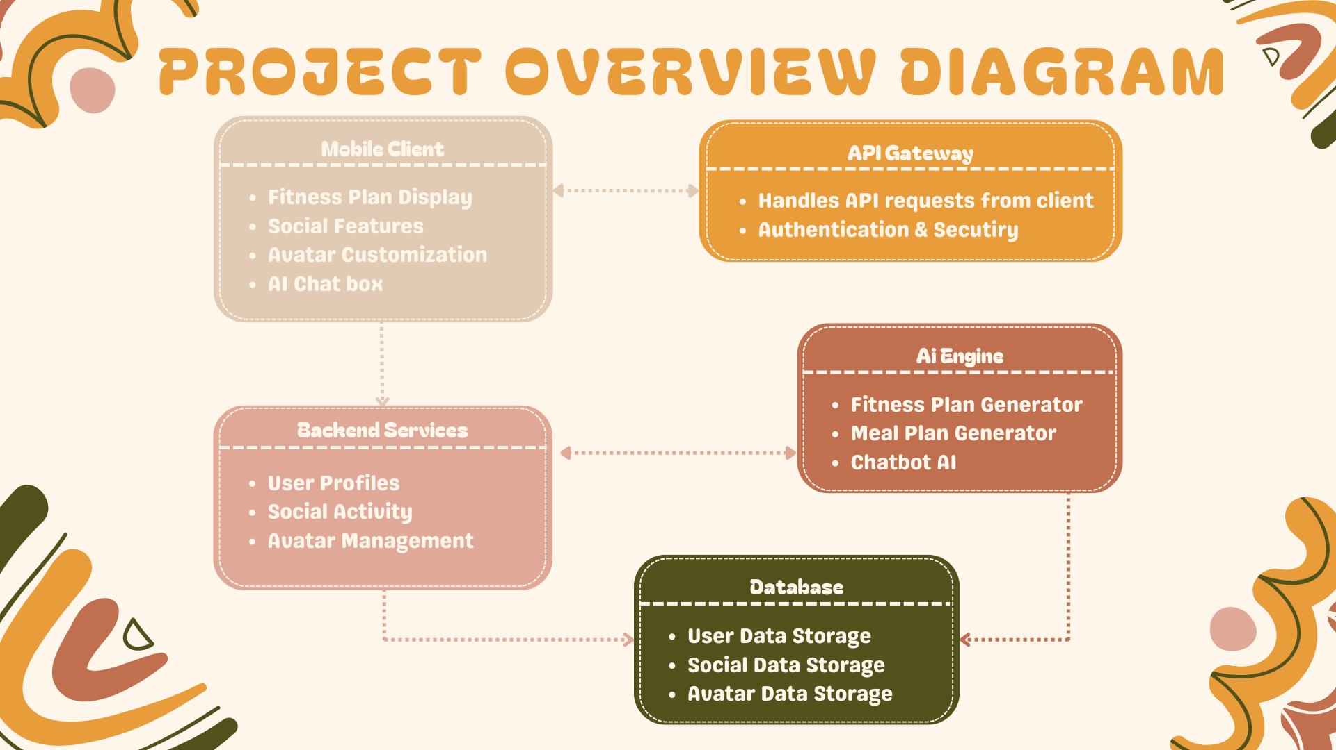

Slide 8
02
Objectives and Goals

Slide 9
Objectives and Goals
SMART Objectives
Specific: Develop a fitness app that tracks user progress and utilizes AI
Measurable: Track team progress by reaching development goals
Achievable: The team will be focusing on developing an app for one platform
Relevant: Aligns with the growing number of health conscious consumers and will keep users engaged through gamification
Time-bound: Define goals, set up tools, gather requirements and design the app this semester. In the second semester code and test app.

Slide 10
03
Scope and Deliverables

Slide 11
Scope
In-Scope
Out-of-Scope
Refers to the boundaries or extent of a project.
User Accounts
Avatar Creation
Fitness Tracking
Game Elements
Basic Analytics
Extensive Game World
Web Based Application

Slide 12
Deliverables
The tangible or intangible outcomes, products, or services that must be completed and delivered as part of a project
User Authentication System
Fitness Tracking Module
Avatar Customization
Data Storage and Sync
Analytics and Reporting
Mobile Application

Slide 13
04
Timeline & Milestones
Each phase is designed to ensure that by the time we’re ready for development, we’ll have a well-documented and thoroughly researched plan that meets user needs and aligns with our project goals

Slide 14
Timeline and Milestones
Milestone 1: Project Initiation & Planning (Weeks 1-5)
Duration: August 26 - September 25
Key Activities:
Define project goals and scope (Week 1)
Form the project team (Weeks 1-2)
Develop a high-level project plan (Weeks 2-3)
Initial Project Plan due for progress report submission (Week 3, Sep 11)
Present the Project Plan (Week 5, Sep 23)

Slide 15
Timeline and Milestones
Milestone 2: Prepare Project Management Tools (Weeks 6-7)
Duration: September 30 - October 9
Key Activities:
Set up project management tools (Jira, SCRUM) (Week 6)
Define workflow and task assignments (Week 7)
Submit Project Management Tool Checklist (Week 7, Oct 09)

Slide 16
Timeline and Milestones
Milestone 3: Requirements Gathering (Weeks 8-11)
Duration: October 14 - November 6
Key Activities:
Conduct user research and collect requirements for the fitness app (Weeks 8-9)
Analyze requirements for the AI chatbot functionality (Weeks 9-10)
Finalize requirements documentation (Week 10)
Present Project Requirements (Week 11, Nov 04)

Slide 17
Timeline and Milestones
Milestone 4: Software Design & Prototyping (Weeks 12-15)
Duration: November 13 - December 4
Key Activities:
Create initial software design and architecture (Weeks 12-13)
Design chatbot integration flow and backend logic (Weeks 13-14)
Prepare wireframes and prototypes for the fitness app (Week 14)
Present the Software Design (Week 15, Dec 02)

Slide 18
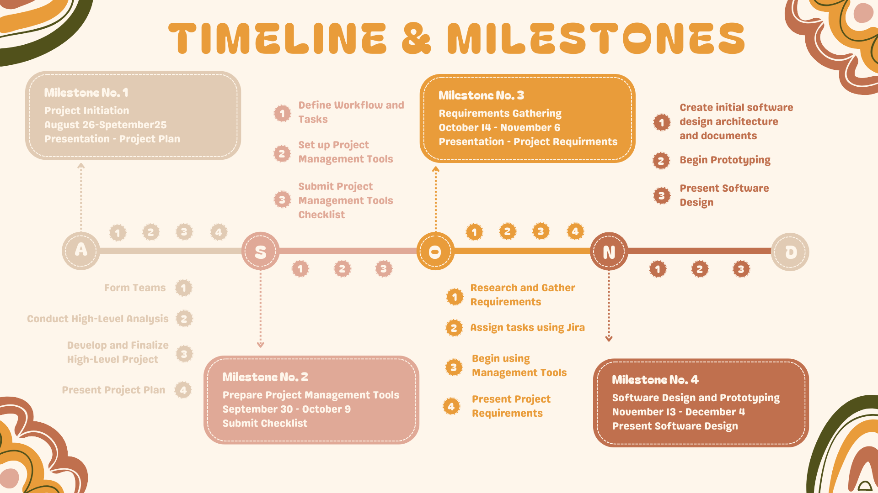

Slide 19
05
Team Roles & Responsibilities
Who’s who?

Slide 20
Team Role and Responsibilities
Project Lead:
Roles:
Isai Flores
Overall coordination and communication.
Developer: [Emanuel] Integrated Firebase and sign-in features; ensured secure user data handling.
Designer & Tester: [Mirna] Led documentation and reports; conducted thorough app testing.
Health Integration Specialist: [Arpa] Connected Apple HealthKit; verified step and calorie tracking accuracy.
AI & Chatbot Engineer: [Sergio] Built chatbot functionality; enforced fitness-only response filtering.

Slide 21
Thanks!
Team #3
Project Lead:
Isai Flores
Team Members:
Emanuel Diaz
Mirna Farahat
Arpa Hakopian
Isai Flores

